Slide 1
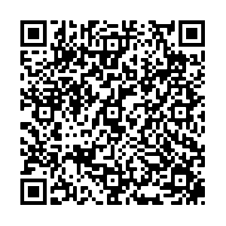
International NGO safeguarding children’s identity rights
through research, reforms and advocacy
Mia Dambach, Executive Director
Mia.dambach@child-identity.org
www.child-identity.org

Slide 2
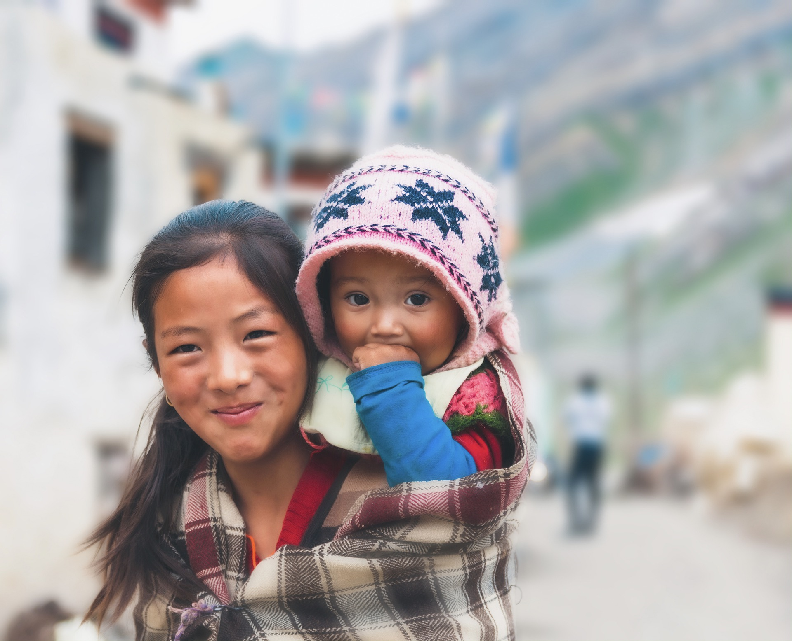
Mission : Child Identity Protection (CHIP) works with States and other stakeholders to promote universal birth registration and full documentation of family relations.

Slide 3
Creation of a child’s identity
’
Child’s right to an identity begins with the right to have the constituent elements of identity inscribed in an official document (e.g.: legal identity, family relations)
Development Legal Atlas on birth registration laws with UNICEF
70 countries finalised (e.g. abandonned, adoption, surrogacy, migration etc.)
To be launched with 100 countries in next six months
Partnership with UNICEF West and Central Africa
Strategic advice on decentralisation, interoperability and digitalisation
Lead Cornelius Williams, former Global Director Child Protection
Cameroon, DRC, Liberia, Niger, Nigeria and Senegal
E.g. Digitilisation in Niger
E.g. Decentralisation in Cameroon (Mayors Forum and NPA)

Slide 4
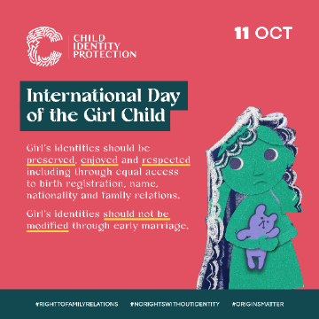
Creation of a child’s identity
Twinning of birth registration and education
Research 2020 Dispositif de détection et d'enregistrement à l'état-civil des élèves sans acte de naissance completed (70 000 children registered)
Issue of children migrating – recommendation re ICCS Conventions
Replicate in other countries (e.g.: Cameroon and Cote d’Ivoire)
1.4 million children unregistered in Cameroon / pilot 48 000 children
Birth and marriage registration to prevent child marriage
Use of birth certificate to prove age
Role of informal and formal marriage frameworks
Benin, Burkina Faso, Chad, Democratic Republic of Congo, Guinea, Mali, Mauritania, Niger, Senegal and Sierra Leone
Book marriage, public announcements, powers of civil registrars etc.
Note : UN study on marriage registration frameworks

Slide 5
Creation of a child’s identity
Advocacy work with 2023 UN resolution on birth registration A/HRC/52/L.23
- Report on birth registration and digital technologies
- Expert meeting held in May 2024
Support with content of final report including informal consultation with UNICEF WCARO
Issue of cross-border movement – ICCS Conventions mentioned as a solution
Work with the CRC Committee
Factsheets submitted on identity issues including birth registration and child marriage
General Comment on Access to Justice and Effective Remedies
Meeting summary and recommendation includes :
Promote the ratification of ICCS Convention No.34 which facilitates the issuance of multilingual and coded extracts/certificates from civil-status records.

Slide 6
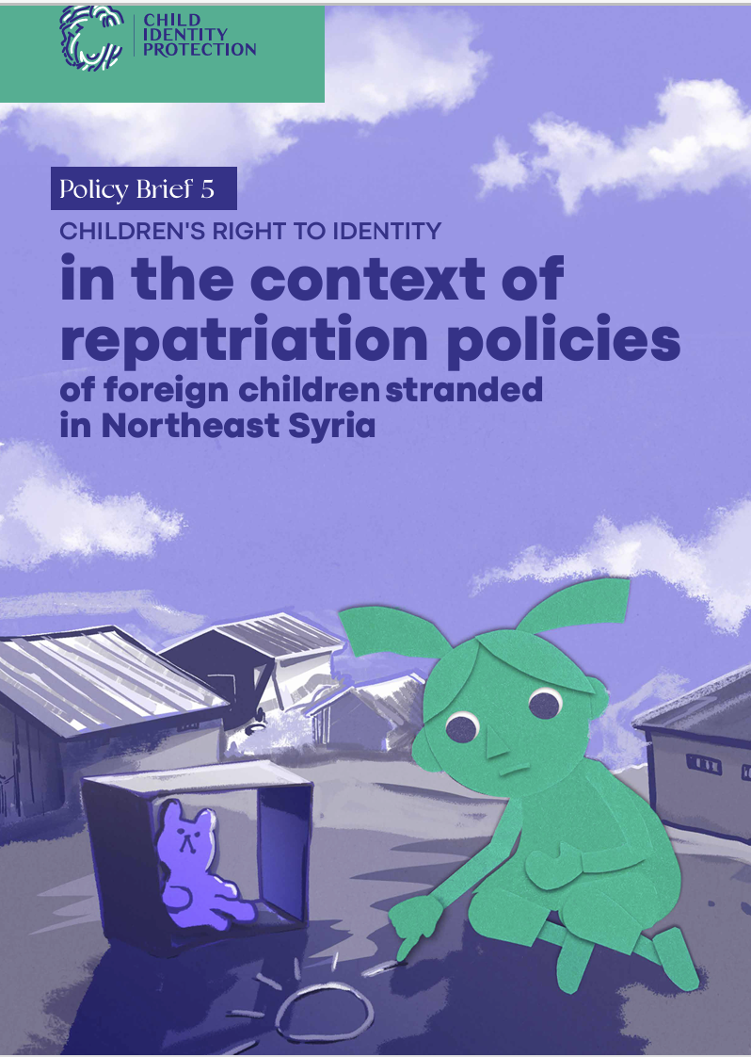
Modification of the child’s identity
Denmark v KK decision legal memo (i.e. discourage use of adoption to regularise ISAs)
Technical and informal consultations with Denmark and Switzerland
Note for intending parents in Switzerland
Surrogacy – permissive and prohibitionist States
Children in North East Syria and family reunification - challenges with birth registration/nationality
ICA – note for search for origins / discussions on « accreditation »
Regional publication in the Americas – right to identity in family relations (e.g. alternative care, adoption, assisted reproductive technology etc.)

